Slide 1

GEETHANJALI INSTITUTE OF SCIENCE AND TECHNOLOGY
Department of Electronics and Communication Engineering

Slide 2
A Technical seminar on Brain Port Vision Technology
Presented by:
P. Rajesh (162U1A04B1)
Under the esteemed Guidance of
Dr. Shaik Mahaboob Basha
Professor, Dept of ECE

Slide 3
Topics Discussed
Statistics on the Blind
What is Brain Port Device?
Discovery of Device
Why known as tasting device?
Why only tongue ?
Parts of Device
Working of Device
Advantages & Disadvantages
Applications
Conclusion
References

Slide 4

Statistics on the Blind
37 million people in the world are blind
Every 5 seconds. One person in our world goes blind
75 million people will be blind by 2020

Slide 5
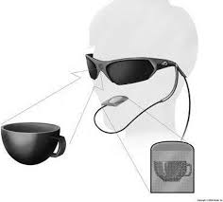
What is Brain Port Device?
Technology developed in US, that allows the blind to ‘see’ using their tongue has been developed by neuro scientists

Slide 6
What is Brain Port Device?
This device sends visual input through tongue
BrainPort could provide vision – impaired people with limited forms of light
Technically this device is underlying a principle called “Electrotactile stimulation for sensory substitution”
Uses a camera to provide tactile vision

Slide 7
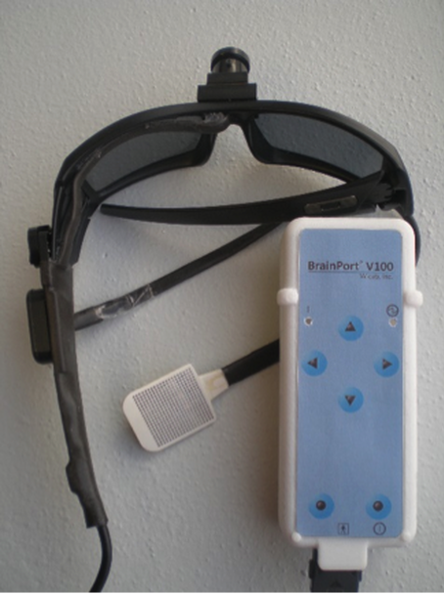
Discovery of device
First sold by Wicab Inc.
Developed by Paul Bach-y Rita in 1998
Aid to people’s sense of balance, particularly of stroke victims.

Slide 8
Why known as tasting device?
Other than normal use of tongue for tasting food, eating, talking there are also many other uses.
One of them is for sensing of light. It is called as tasting because it can taste the light and sense the objects.
It is the property which is used in BrainPort vision device.

Slide 9
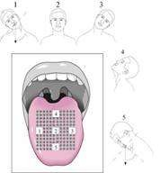
Why only tongue ?
More sensitive
Ideal place to provide information through tactile stimulation
Absence of stratum corneum
Constant moisture - Constant electric conductivity.

Slide 10
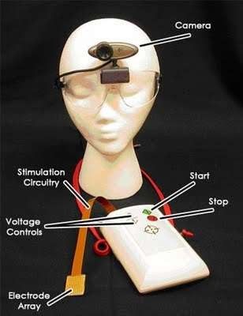
Structure of BrainPort vision device
Digital Video Camera
Brain Port Balance
Electrode Array
Simulation circuitry
Accelerometer

Slide 11
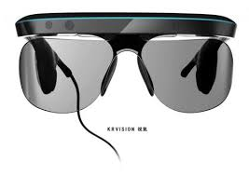
Digital Video Camera
A digital video camera placed in the pair of glasses.
Visual data is captured through the camera (1.5cm in diameter).
Passed to the Brain port device along a cable
Then to the lollipop- shaped stick, placed on the tongue.

Slide 12
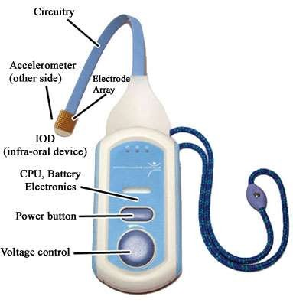
Brain Port Device
Power Button
Control Unit
Lollipop shaped stick
Electrode Array
Simulation circuitry
Accelerometer

Slide 13
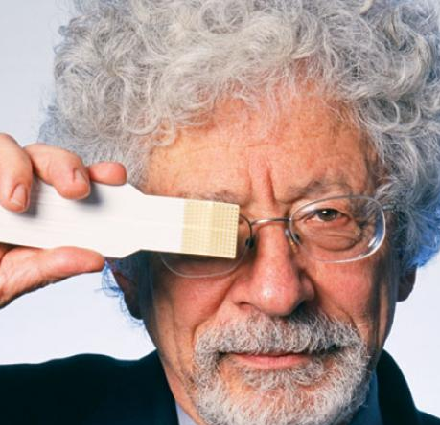
Electrode Array
Lollipop like Structure
Contains a square grid of 400 electrodes
Electrodes pulse according to light intensity in particular area of the picture.
Converts pictures into electrical pulses and it is placed on tongue.

Slide 14
Simulation Circuitry
Programming device comprises of user interface and a processor
Converts digital inputs to electrical stimulations
Accelerometer
Provides head and body position information to the brain through electro-tactile stimulation of the tongue.

Slide 15
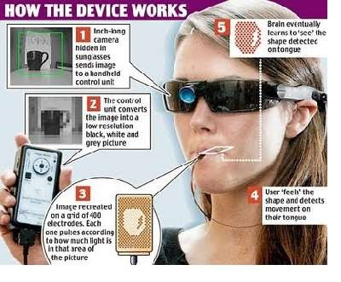
Working of Device

Slide 16
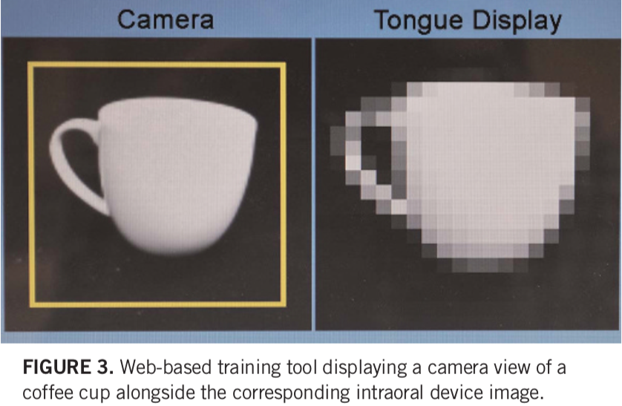

Slide 17

Advantages
Blind users can use at home, at work, and in public places
Can operate it independently with a hand-held controller
Rechargeable battery like in normal cell phones.
Object recognition
Locating people and known objects such as shoes, cane, coffee mug, keys

Slide 18

Disadvantages
Can’t be adapted to work on senses that brain doesn’t already have.
Requ ire training
High cost
Provides limited forms of sight only
Produce weak metallic taste sensations, a minor side effect.

Slide 19
Applications
Medical
Car Racing
Robotic Surgery
Military
Video gaming

Slide 20
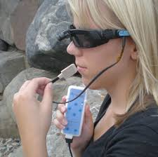
Conclusion
BrainPort envisions has a great scope in future
Researches working towards making device more user-friendly, economical and smaller
Working towards the size of camera should be a grain of rice embedded in forehead
Thus we hope that blind people can also see this colourful world by using this brain port device.

Slide 21
References
Bach-y-Rita, Paul et al. "Form perception with a 49-point electrotactile stimulus array on the tongue: A technical note." Journal of Rehabilitation Research and Development, 1998. http://kaz.med.wisc.edu/Publications/1998-BachyRita-JRRD-Tongue.pdf
Wicab, Inc. http://www.wicab.com/
"Wicab to present BrainPort at Boston conference." WTN News. Oct. 4, 2005. http://wistechnology.com/printarticle.php?id=2319
U.S. Patent #6,430,450. "Tongue placed tactile output device."

Slide 22

Any Queries?

